Slide 1
Roseville, formerly Leixlip Gate Lodge to Lucan Demesne: Part 2, Mainly Before Recent Developments
Compiled by John Colgan ©

Slide 2
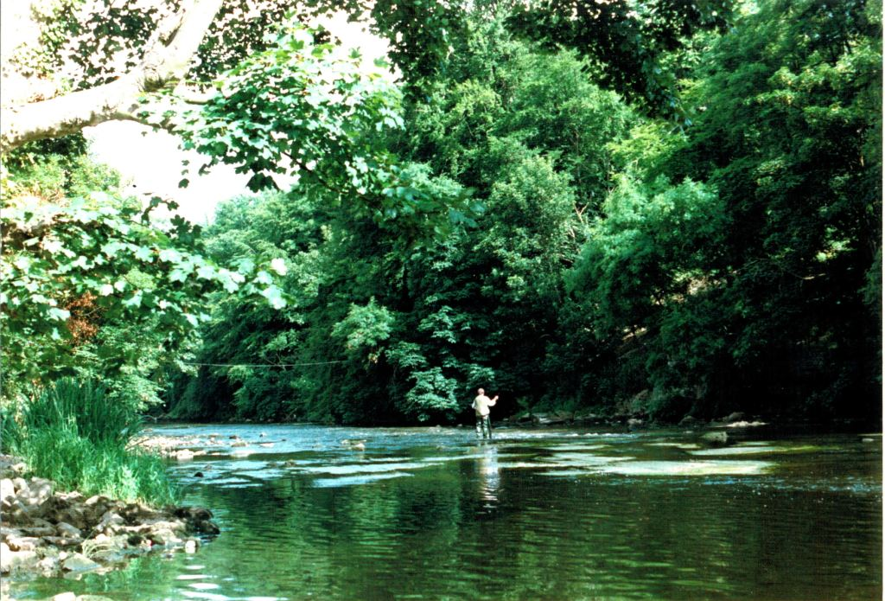
This is a scan of a conventional photograph taken from the Toll House garden looking south-eastward down the Liffey at the angler. The overhead cable defines its location. The cable is a television aerial wire supplying Cache Creek, then the home of the late Prof Valentine Rice from a pole on the public parkland behind Castle Park, Leixlip. The scan is dated 27/12/2007; the photo was taken ca 2002. The rocky outcrop is visible.

Slide 3
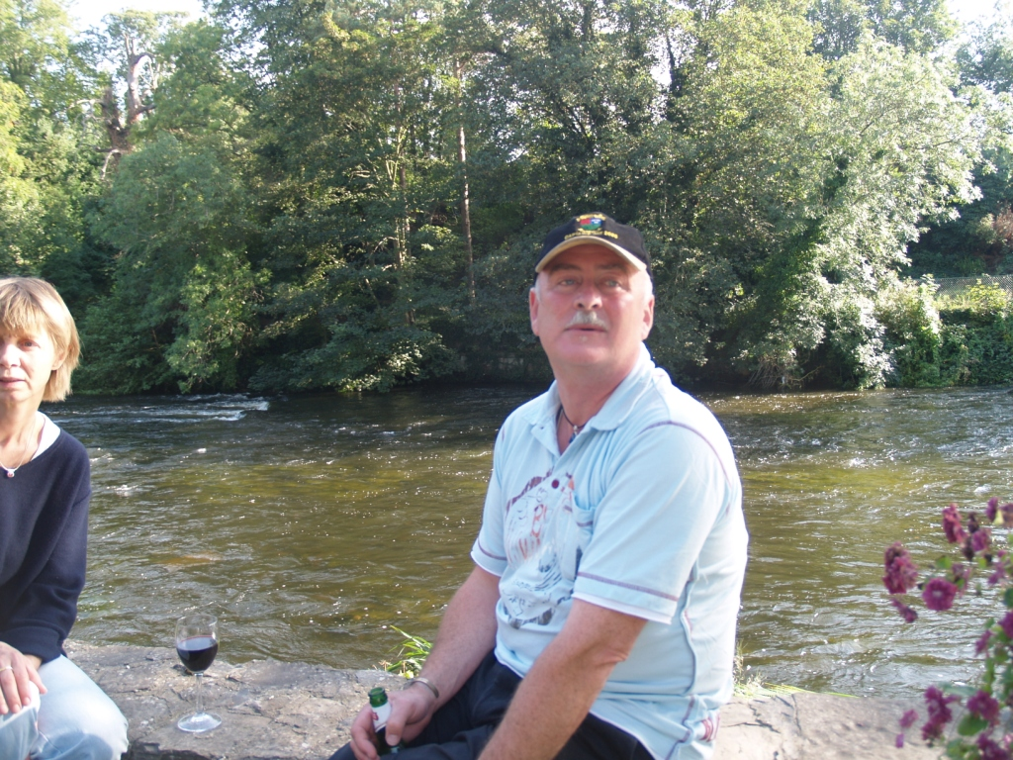
Almost all the ‘before’ pictures, were incidental shots of the Roseville property from the garden of the Toll House. The white water towards the South bank of the Liffey is over a rock outcrop, readily located. This photo was taken on 9/9/2006. The flowers to the right were growing in a centrally placed cut stone on the riverside wall of the Toll House garden, which stretches in a rectangular plot northwards. The overhanging trees provide flies for fish and cover to wild animals, such as foxes, badgers, herons, kingfishers, otters, ducks, etc

Slide 4
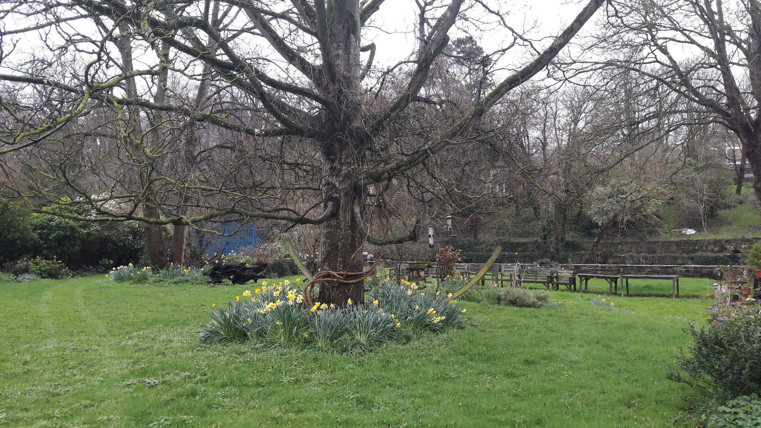
Photo taken, 22/3/2017 , from the upper garden level (about 0.8m higher than that section contiguous to the riverside wall; this was before planning permission had been applied for at Roseville. The square panelled building in the right hand top corner is part of Leixlip Potable Water Works, across the Leixlip-Lucan Road into Leixlip. There’s almost no trace of the Roseville cottage before its expansion to be seen, and none of cars on the site. Before its sale, Roseville had one car, and at most two, not the four claimed in the planning application. 3 off 200 year old sycamores…

Slide 5
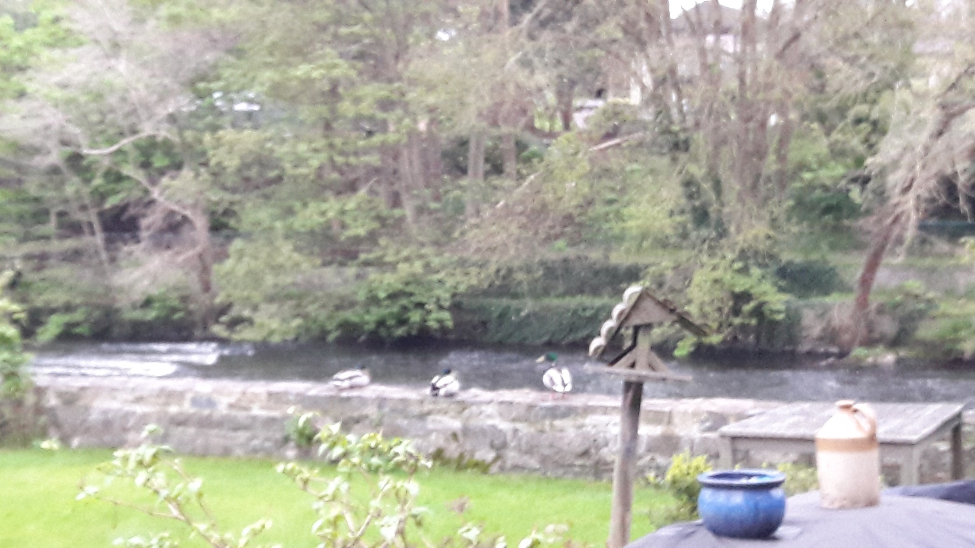
Photo taken on 19/4/2017, two weeks after the planning application. The timber is already being cut at the top of the site, exposing the north side of Roseville cottage. The picture was aimed at the three ducks resting on the river containment wall of the Toll House garden. The white water to the left is revealing the rocky outcrop there.

Slide 6
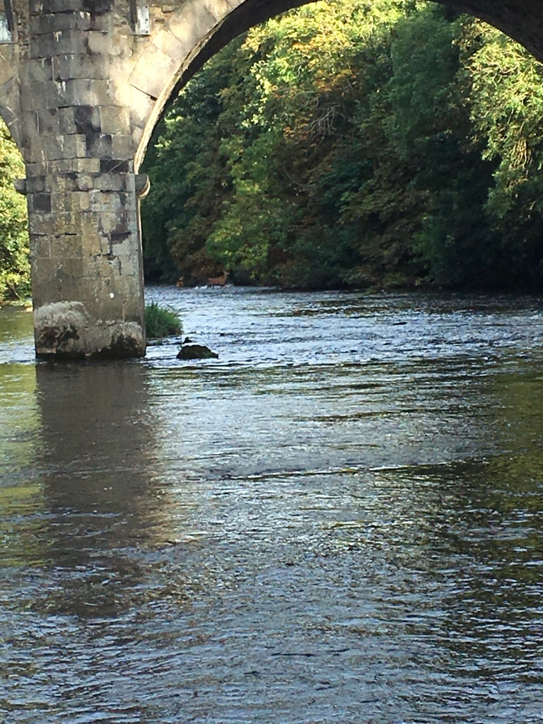
Pic taken 14/9/2018 by Mattie Pederson, a Danish canoeist, here for the annual Liffey Descent Canoe Race, through the central arch of Leixlip Bridge, from west to east. It was to show a deer which waded up the Liffey over on the South bank. Overhanging vegetation on the south bank looks intact.

Slide 7
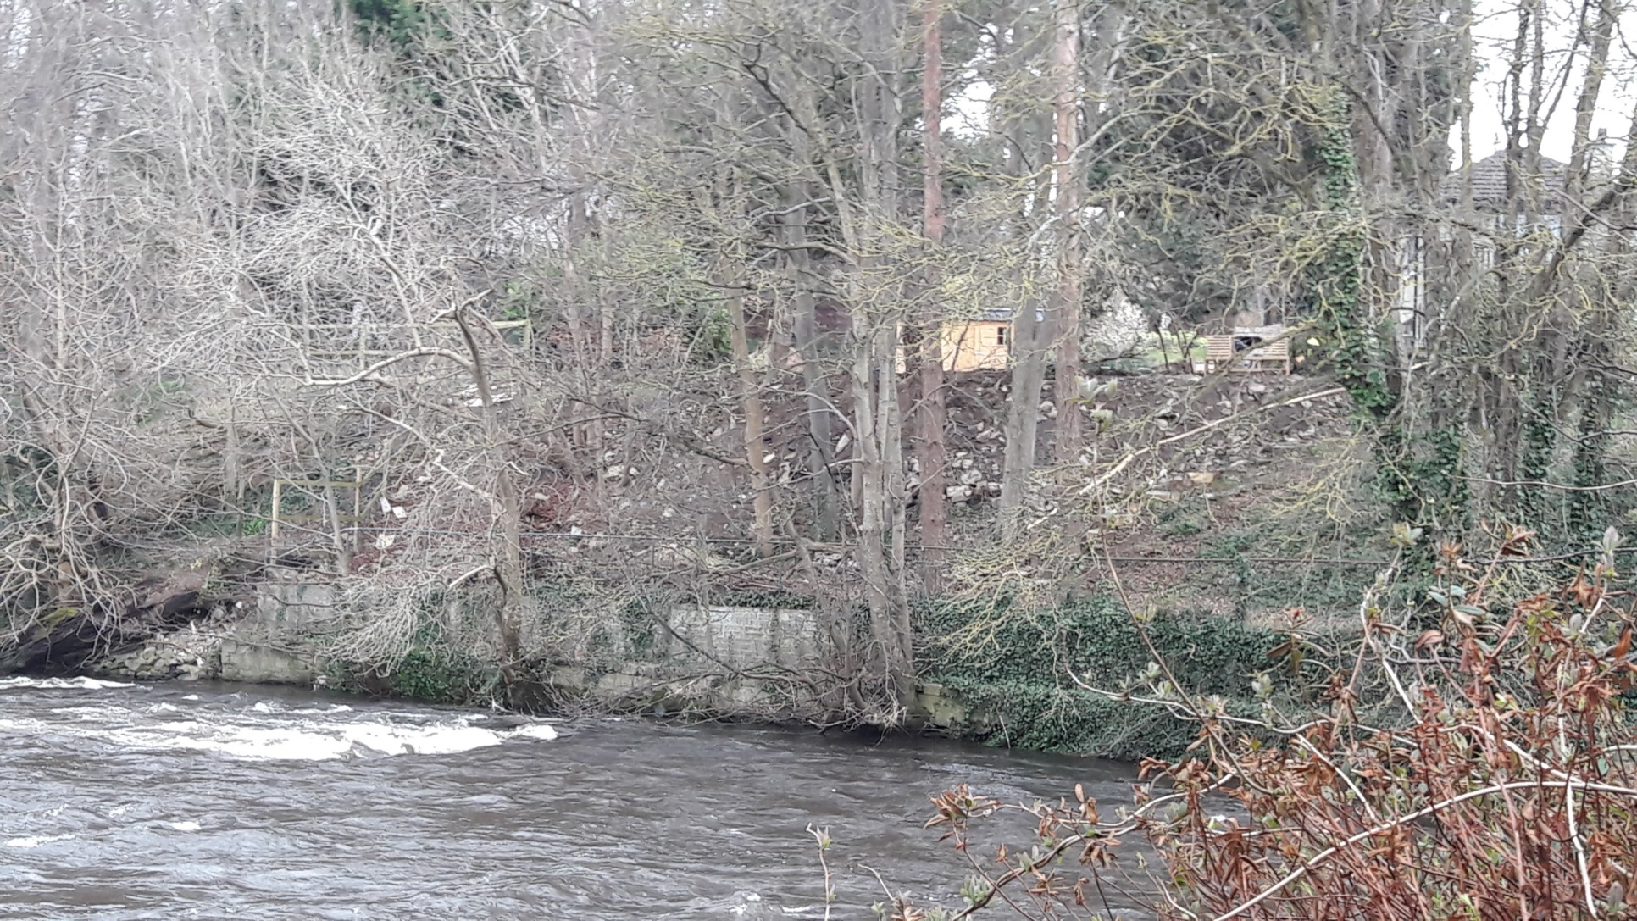
South bank of Roseville general site cut back in this photo of 26/3/2018. The owner/occupier of Roseville Cottage may not own this formerly wooded part of the Liffey Valley, which belonged to Lucan Demesne. More trees were cut and some fell in very strong wind into the river, being deprived of the cover they hitherto enjoyed. The creamy butts of trees are visible. A wooden shed, coloured yellow, has been erected. Fires have been lit on the bank at the east end, as recently as 20/3/2021.

Slide 8
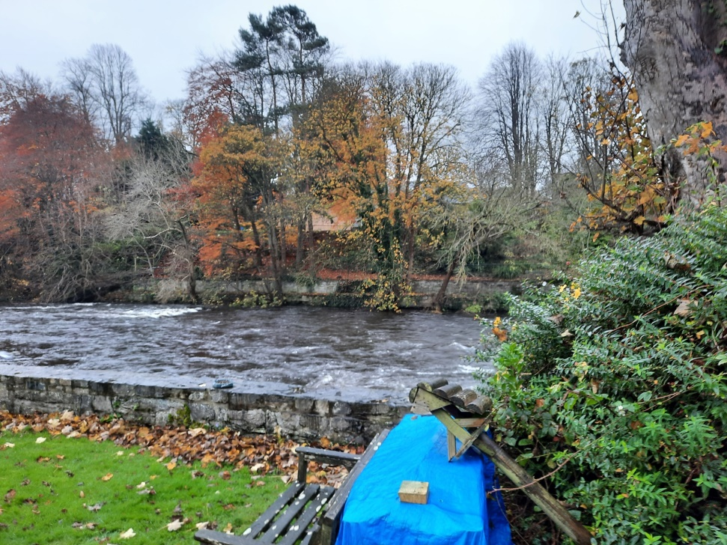
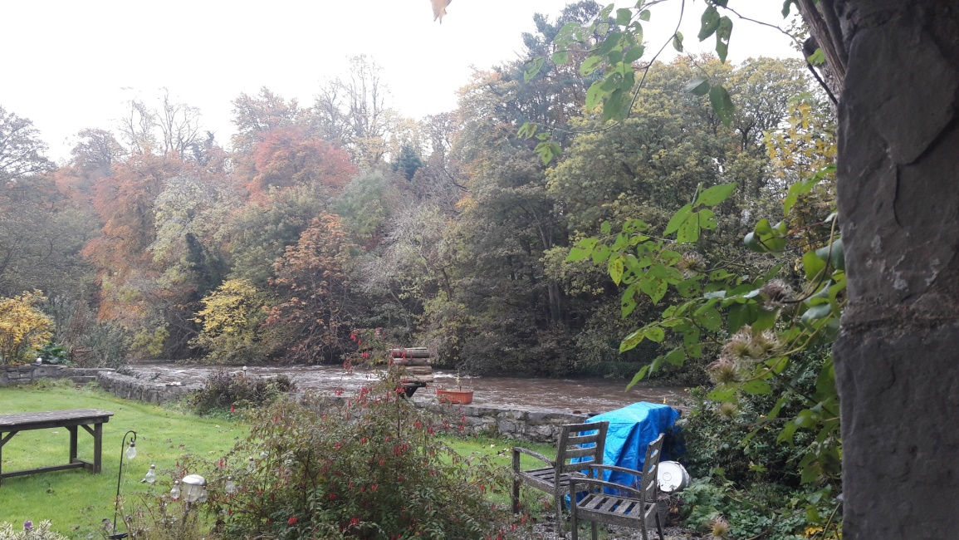
Picture on the left taken on 3/11/2019. Picture on the right taken a year later on 15/11/2020. More timber was cut, apparently at the behest of Roseville owner/occupiers, either directly or by agents.

Slide 9
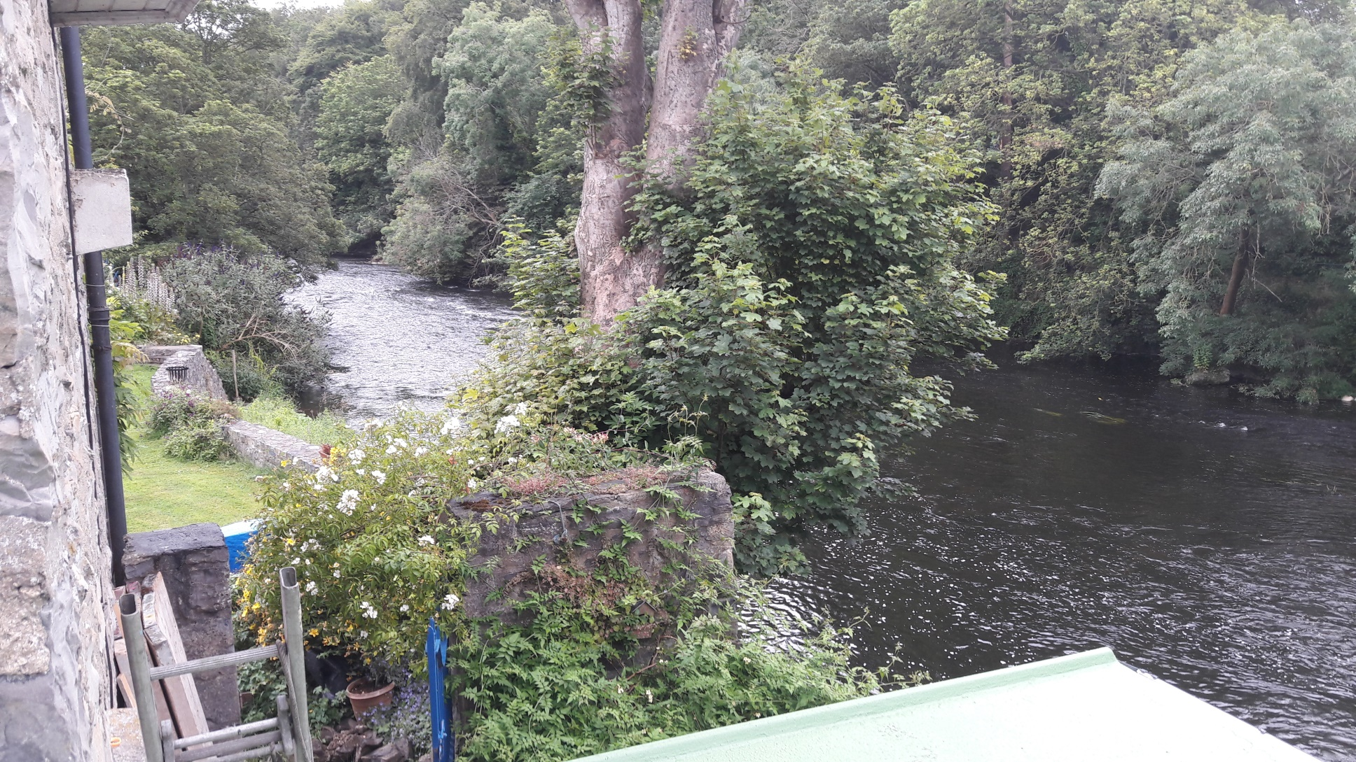
South bank, long view, from roof of Toll House extension. Sycamore by river edge in foreground, 17/7/2019

Slide 10
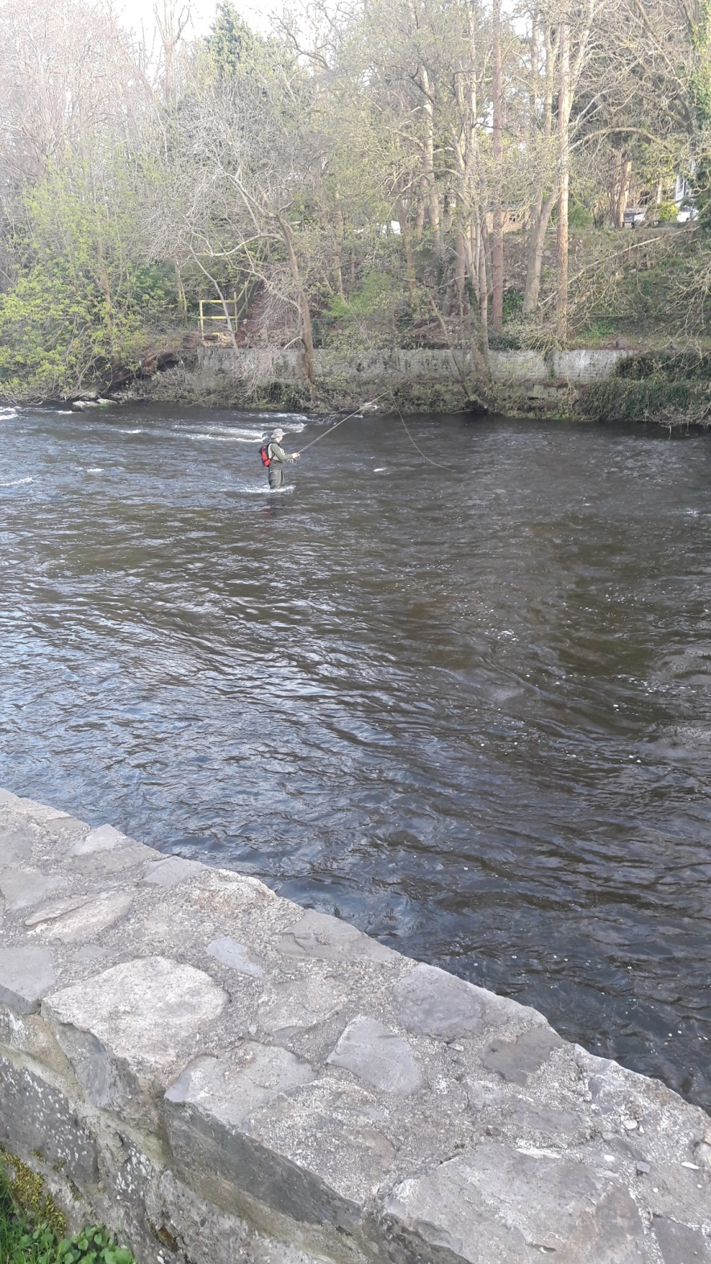
Photo taken, 8/4/2020 from the garden of the Toll House, near the Liffeyside containment wall, which we rebuilt after it collapsed under 1970s ownership.
All of the timber at the front of the plateau, the lawn of Roseville, has since been removed. Also the vegetation on the escarpment down to the upper of the two riverside containment walls. I witnessed two women raking it off and down the embankment.

Slide 11
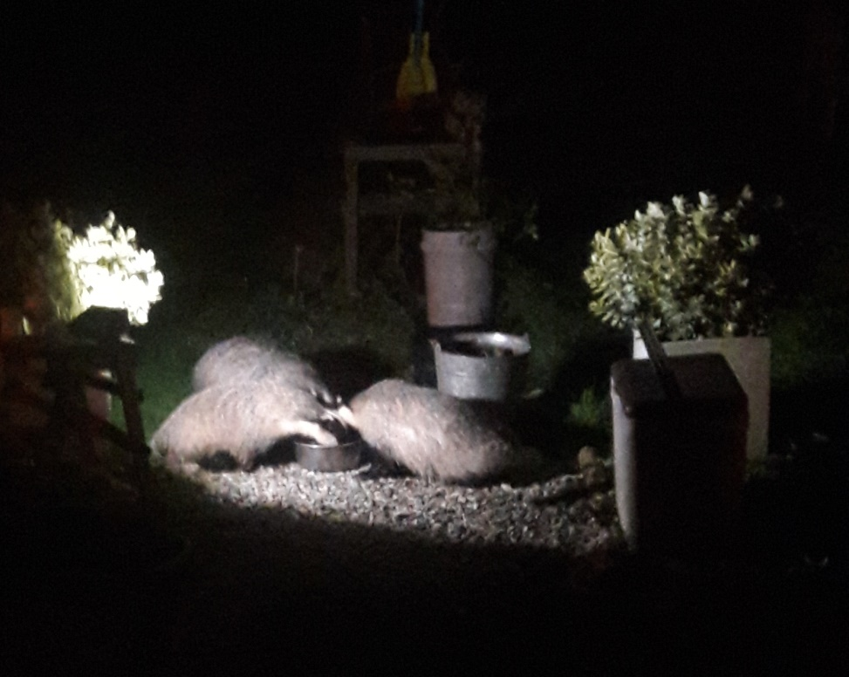
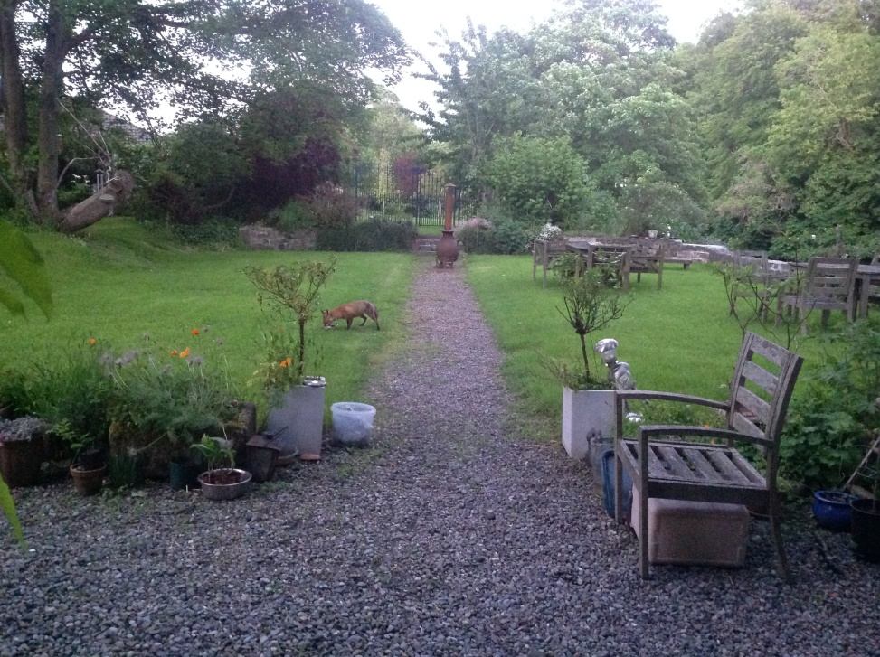
Examples of Wildlife hereabouts, facilitated by wooded wilderness
Badgers
Fox

Slide 12
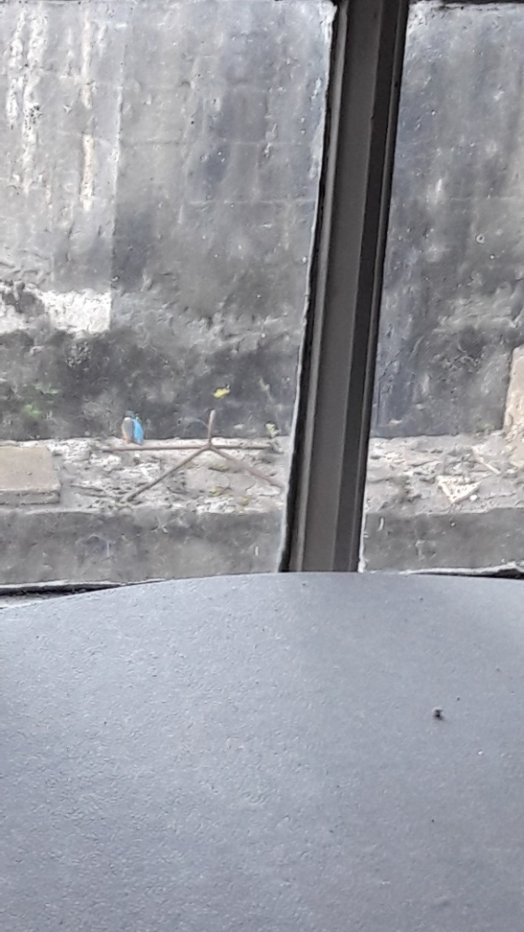
More examples of Wildlife hereabouts, facilitated by wooded wilderness
Heron
Kingfisher watching…
Because what I have is a video, a recent image of a heron on the riverside wall cannot be inserted here.

